Slide 1
Data Analysis Project- 2 on
Prepared By: Madhumalinee Aryaratna
Data Visualization of Bird Strikes between 2000 – 2011

Slide 2
Contents of the presentation
Introduction | To understand the situation and problem statement of the project.
Understanding the data | Understanding the data which would be used for data analysis.
How did we go about this project? Data pre processing | Looking through data pre processing steps like data cleaning, dealing with outliers, missing values, duplicates, data transformation.
Data Analysis- Insights (EDA) | Performing data analysis and getting insights regarding the situation.
Reccomendations | Providing recommendations based on the insights generated.

Slide 3
01.
Introduction
Understanding the situation and problem statement of the project.

Slide 4
Introduction
Environmental impacts and safety are, nowadays, two major concerns of the scientific community with respect to transport scenarios and to the ever-growing urban areas.
Bird Strike is common and can be a significant threat to aircraft safety. For smaller aircraft, significant damage may be caused to the aircraft structure and all aircraft, especially jet-engine ones, are vulnerable to the loss of thrust which can follow the ingestion of birds into engine air intakes. This has resulted in several fatal accidents.
This is causing an impact in the flights and we need to analyze the following –
What is the bird strike number over the years if it has increased or decreased.
What are the factors that are leading to the bird strike
Analyze how it is affecting the flights.
How it could be avoided in any way and finding solution to this problem.

Slide 5
02.
Understanding the dataset
Understanding the data which would be used for data analysis.

Slide 6
Understanding the dataset
Dataset Link:
https://github.com/Madhumalinee/Visualization-of-bird-strike-between-2001-2011/blob/main/Bird%20Strikes%20data.xlsx
About Dataset
In this data set, we have 26 columns in total, which are Record ID, Aircraft: Type, Airport: Name, Altitude bin, Aircraft: Make/Model, Wildlife: Number struck, Wildlife: Number Struck Actual, Effect: Impact to flight, Flight Date, Effect: Indicated Damage, Aircraft: Number of engines?, Aircraft: Airline/Operator, Origin State, When: Phase of flight, Conditions: Precipitation, Remains of wildlife collected?, Remains of wildlife sent to Smithsonian, Remarks, Wildlife: Size, Conditions: Sky, Wildlife: Species, Pilot warned of birds or wildlife?, Cost: Total $, Feet above ground, Number of people injured, Is Aircraft Large?
Tools Used for Data Analysis
Python

Slide 7
03.
How did we go about this project?
Looking through the steps performed prior to EDA - Data pre processing.

Slide 8
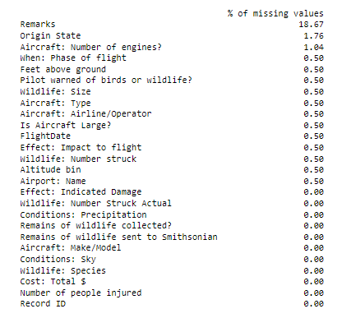
Data Pre processing
I. Dealing with missing values
In this data set, we have 15 columns, which had missing values, and we dealt with each of the features differently based on their relevance and the % of the missing values.
We dropped the rows of columns containing NA values which had missing % of 0.5% as dropping it would not affect our analysis.
For columns- origin state and aircraft: number of engine, the values were replaced with mode as the % of missing values were slightly higher than 1%.
For remarks column, we left it as it is, as we did not require that for our analysis at any point of time, so it was dropped completely.

Slide 9
Data Pre processing
II. Dealing with missing values & Data cleaning
(data[data['Conditions: Precipitation']=="None"].shape[0]/ data.shape[0])*100
The above code, gave us the result that the parameter had 92.07% none values, so either we could drop it or impute it.
However, as the none value was too high, so it would not be correct to impute it with mode and it would be of no use to our data. It was not used to perform data analysis.
As the column “Aircraft type had only one type of data, so it was removed from the dataset. There were no duplicate records found in the dataset.
Another new column named as “Year” was created from the flight date column to easily analyze yearly data if required.
In total, the dataset had 25 columns and 25429 rows after dropping “aircraft type” column.

Slide 10
Data Analysis- Insights (EDA)
04.
Performing data analysis and getting insights regarding the situation.

Slide 11
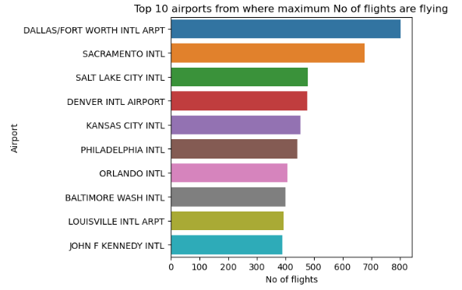
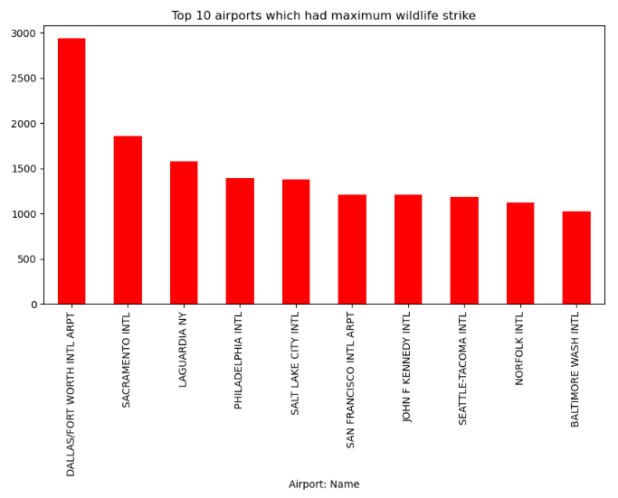
Top 10:
I. Airports from where maximum flights are taken
II. Airports from where maximum bird strike

Slide 12
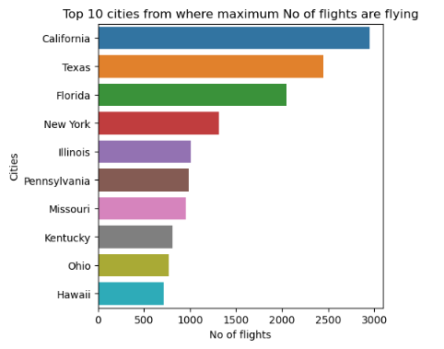
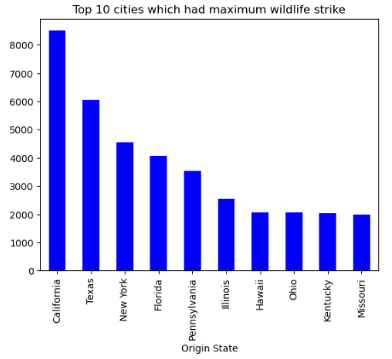
Top 10:
III. Cities from where maximum number of flying are flying
IV. Cities from where maximum bird strike is occurring

Slide 13
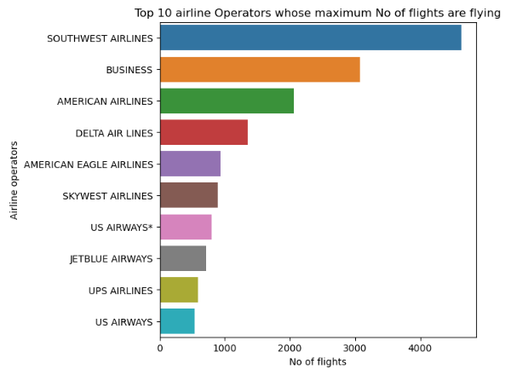
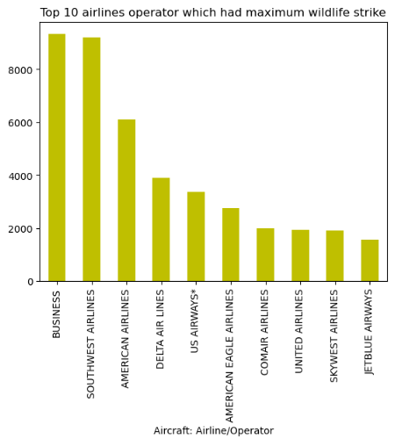
Top 10:
V. Airline operators having maximum number of flights
VI. Airline operators from where maximum bird strike is occurring

Slide 14
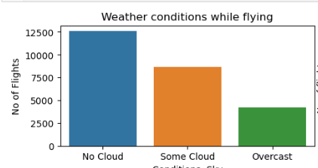
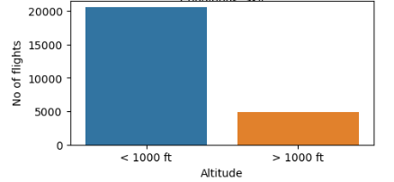
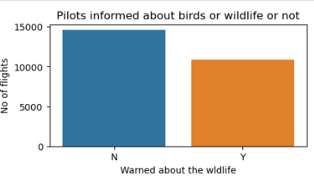
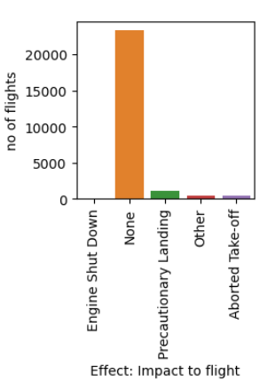
Insights On Current Scenario
Weather Condition vs Number of flights
Altitude vs Number of flights
Insights
Flights are flying majorly in “No cloud” situations.
Maximum flights are flying in <1000ft altitude.
Maximum time pilots were not informed about the wildlife.
Majority of flights were not impacted due to bird strike.
Pilots informed vs Number of flights
Impact to flights vs Number of flights

Slide 15
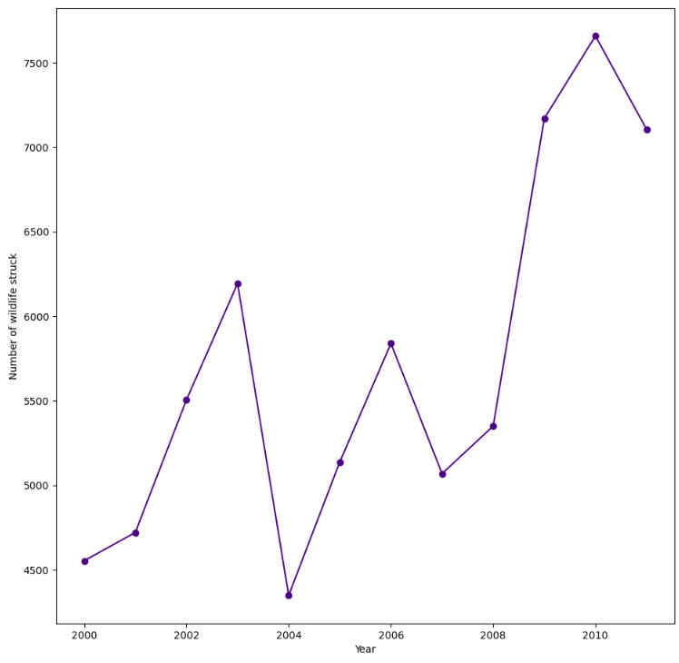
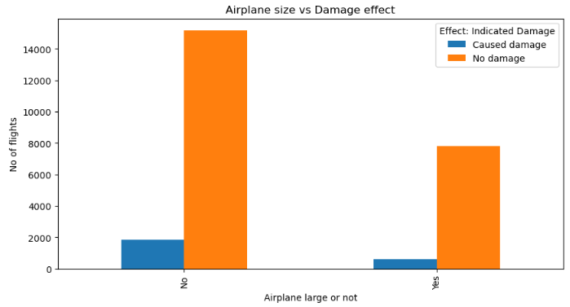
Insights On Current Scenario
Number of Wildlife strike over Years
Airplane Size vs Damage
Insights
Over the years, the wildlife strike has increased.
Minimum strike was in 2004 and maximum strike was in 2010.
Small size planes are more damaged as compared to larger planes due to bird strike.

Slide 16
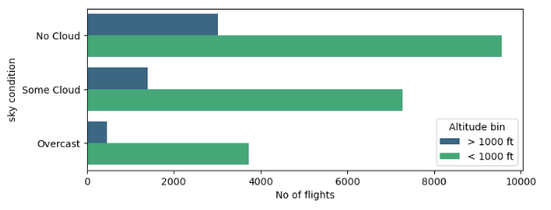
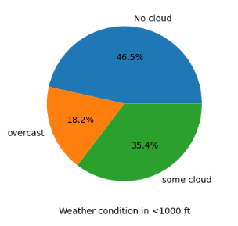
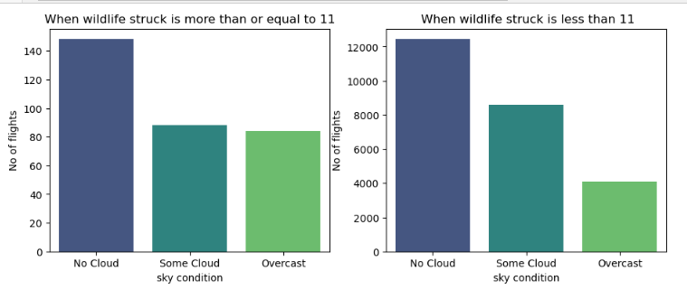
Insights On Sky Condition
Altitude Vs Sky condition
Number of wildlife strike vs sky condition
Insights
In both altitude categories, whether it be >1000 ft. or < 1000ft., maximum flights are flying in “No cloud” condition, followed by “Some cloud” and “Overcast” condition.
The Number of wildlife struck is highest when there is no cloud sky condition. This might be because birds or wildlife are flying in higher numbers when the sky is clear.

Slide 17
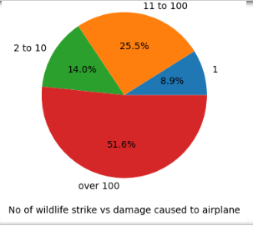
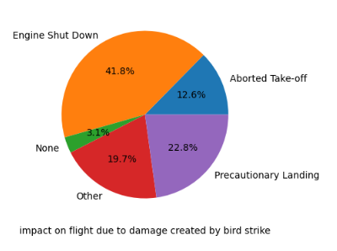
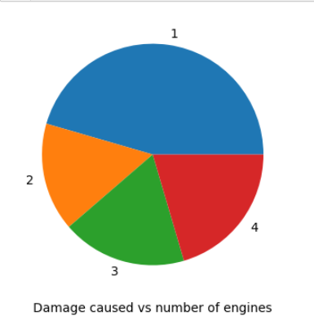
Insights On Damage Caused & Impact On Flight
Wildlife struck vs damage caused
Impacts on flights when damage is caused
Damage caused vs Number of engines
Insights
More than 50% of the times, when damage is caused it is caused when a flight strikes more than 100 birds. More is the number of wildlife strikes by a flight, more is the damage.
Majority of the time, engine shuts down, followed by precautionary landing are the 2 major impacts on flights when there's a damage to the airplane caused by bird strike.
Number of engines does not really affect whether there will be any damage caused to the airplanes or not, as seen that airplanes with engines more than 2 have similar chances of getting damaged.

Slide 18
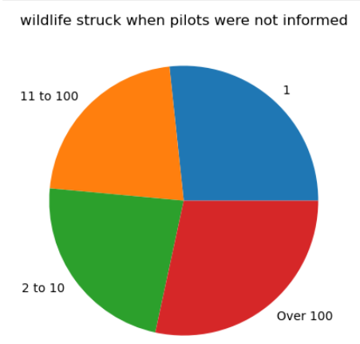
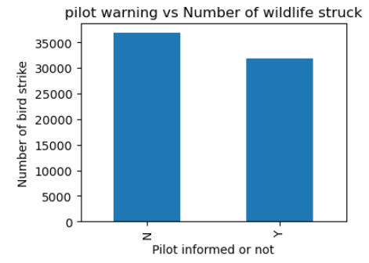
Insights On Warnings Given To Pilot
Pilots not informed vs number of wildlife strike
Pilots informed vs Number of strike
Insights
When pilots were not informed about the wildlife, almost 50% of time, the plane hit a bird for all categories of number of wildlife.
There are more cases of wildlife hit when pilots are not informed about it in prior.

Slide 19
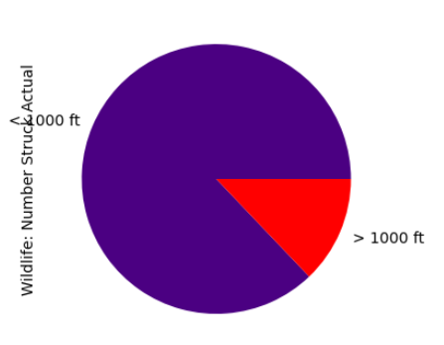
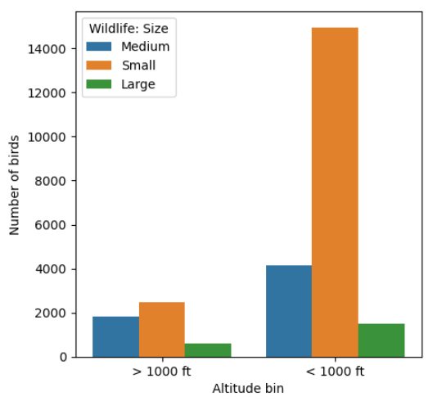
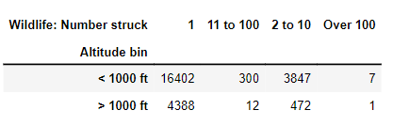
Insights On Altitude
Altitude vs Number of wildlife strike
Altitude vs wildlife size
Altitude vs Number of wildlife strike
Insights
Majority of hits/ strikes are taking place in the below 1000ft altitude, and few cases are taking place above 1000 ft.
In both height ranges, small size wildlife are prevalent or more in number as compared to the large and medium size.
In <1000ft. Maximum number of wildlife are flying, so maximum number of strikes occuring.

Slide 20
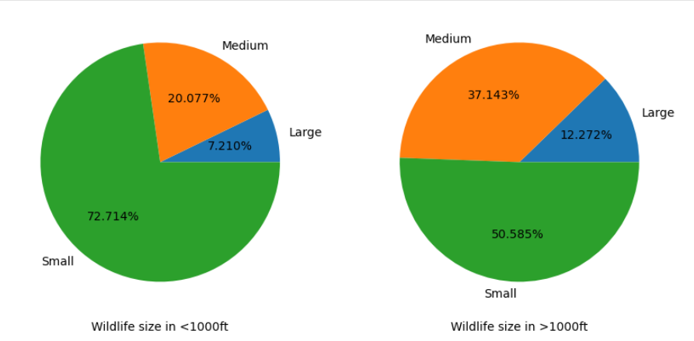
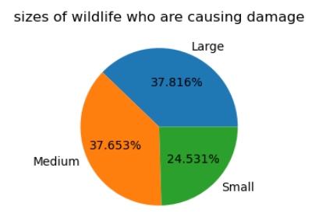
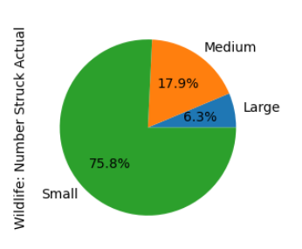
Insights On Wildlife Size
Altitude vs wildlife size
Wildlife size vs damage caused
Size vs Number of wildlife strike
Insights
In <1000ft. About 72.71% of the birds flying are of small size whereas 51% of birds flying in >1000ft. are of small size. Larger and medium birds comprises of other 50% in the higher altitudes.
Large and medium sized wildlife are causing more damage as compared to the smaller sized wildlife.
Smaller wildlife are more hit by the airplanes as compared to the medium and large sized, which might be because they are flying more in below 1000ft.

Slide 21
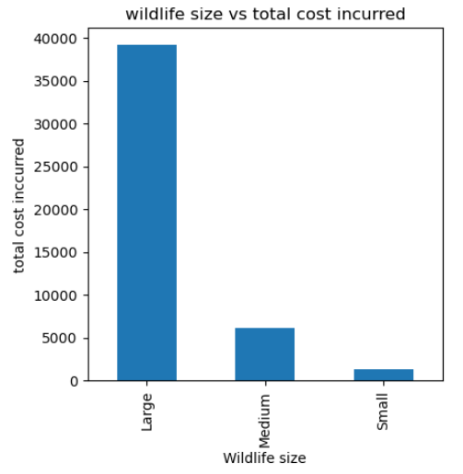
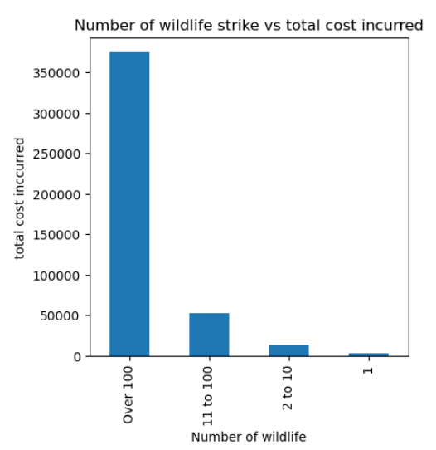
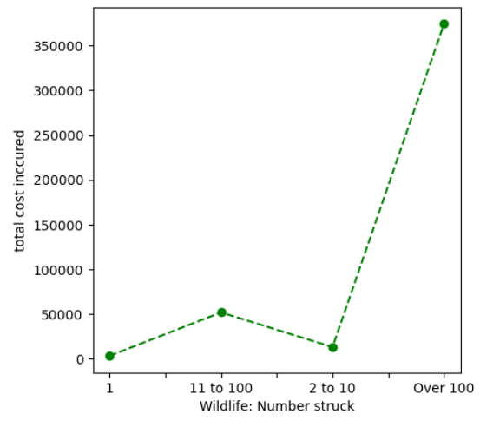
Insights On Total Cost Incurred- I
Total Cost vs wildlife size
Wildlife size vs damage caused
Insights
Cost incurred when large sized wildlife hits are much higher as compared to the medium and small sized wildlife.
More the number of wildlife an airplane hits, more is the cost incurred to repair the damage.

Slide 22
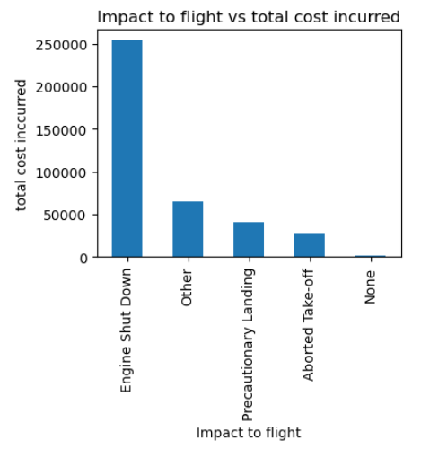
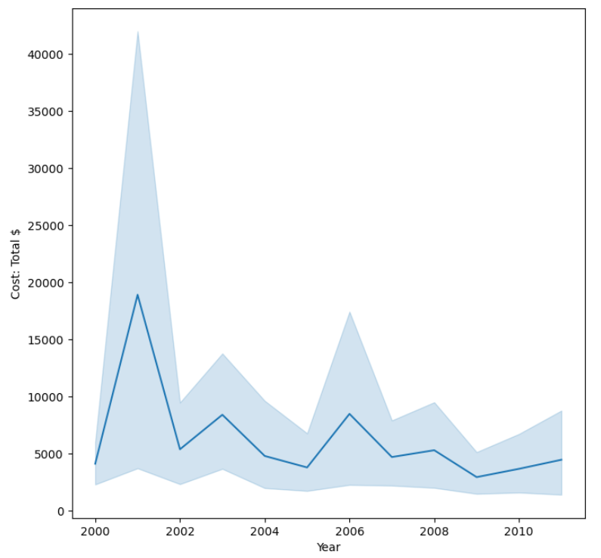
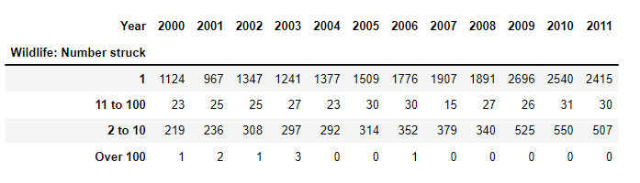
Insights on Total Cost Incurred- II
Total Cost vs Impact on flight
Yearly Cost Incurred
Insights
Cost incurred are higher when there is engine shut down, and least when there is no impact on flight due to bird strike.
Over the years the cost incurred has decreased, which might be due to decrease in the number of huge number of wildlife strike by a single plane.

Slide 23
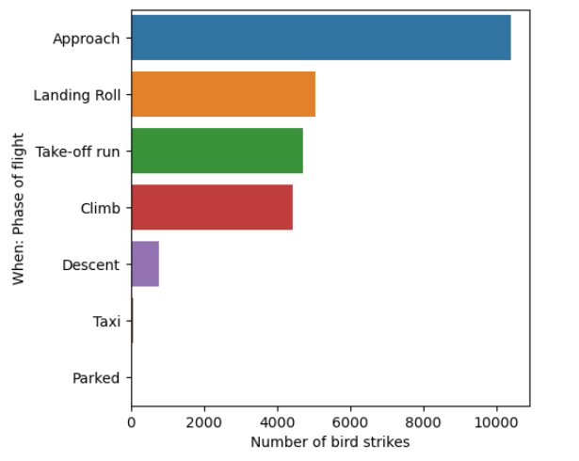
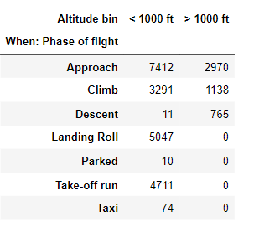
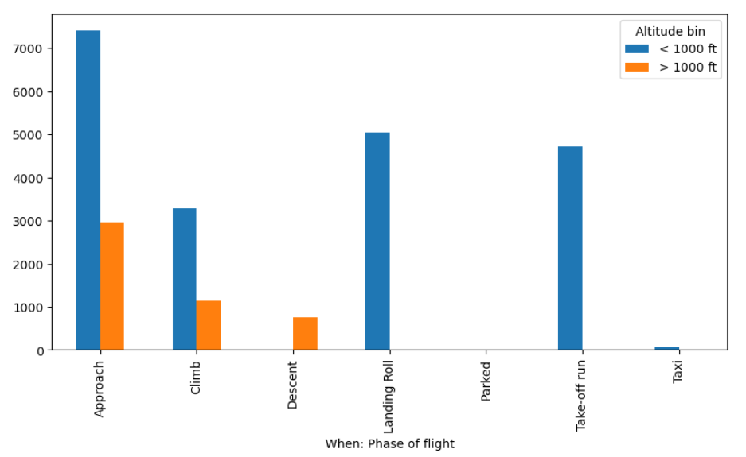
Insights On Phase Of Flight
Number of Bird Strikes vs Phase of flight
Yearly Cost Incurred
Insights
Maximum bird strikes are happening in the Approach and Landing roll phase.
As checked, during these 2 phases, the planes fly in <1000ft., so we can confirm that the bird strikes are higher in this phase as they are flying in that range and at a speed.

Slide 24
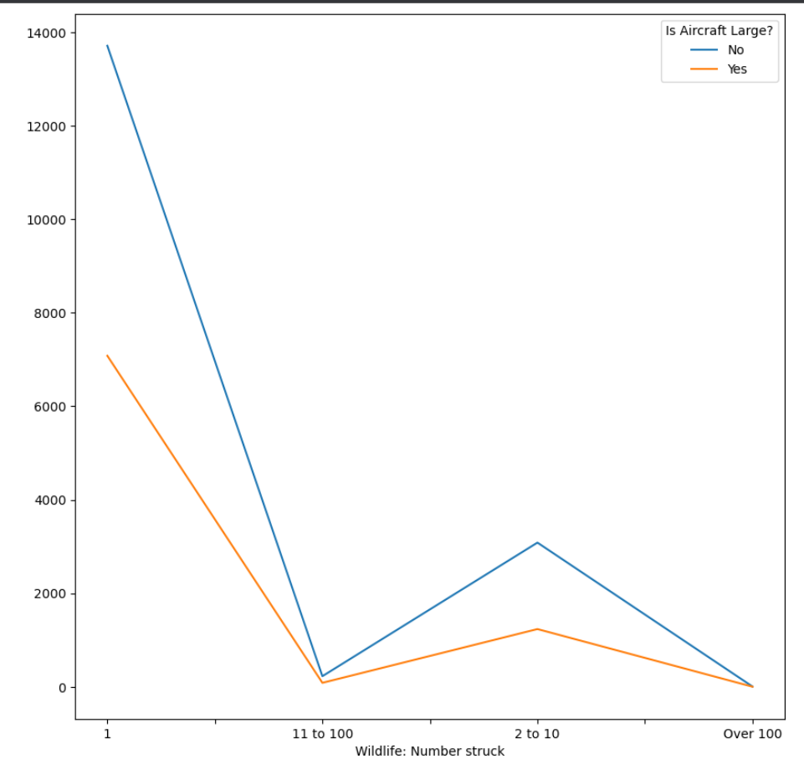
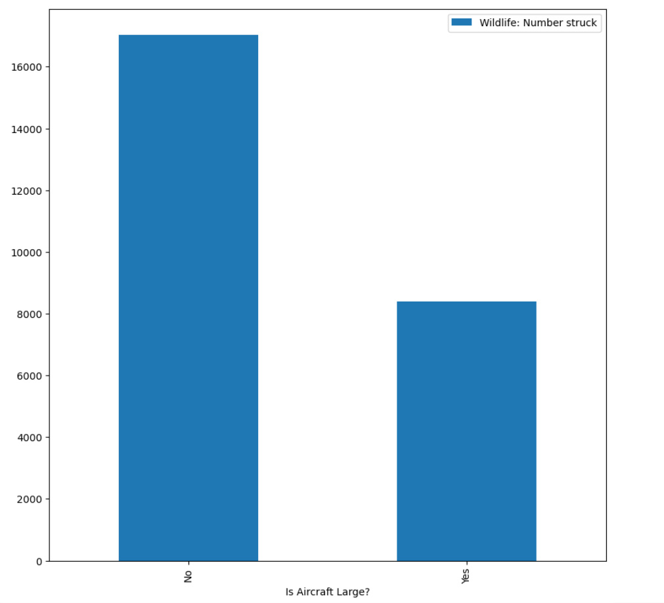
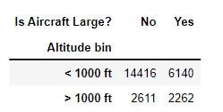
Insights On Airplane Size
Number of Bird Strikes vs Airplane Size
Insights
Smaller aircrafts are hitting the wildlife majorly as compared to the larger aircrafts.
They are hitting less than 11 wildlife majority of time in one flight duration, followed by 11 to 100 and then over 100, which might be due to the altitude in which they are flying i.e. less than 1000ft.

Slide 25
Conclusion On The Basis Of Insights Formed
On the basis of the analysis of data, we are able to reach to the below conclusions.
1. Factors on which the bird strike depend are-
Altitude in which the plane is flying.
(<1000 ft.)
Sky Condition
(No Cloud conditions)
Phase of Flights
(During Approach & Landing Roll)
Pilots were informed or not
(When Pilots are not informed)
2. Factors on which the airplane damage depend are-
Aircraft Size
(Smaller the size higher the damage)
Wildlife Size
(Larger the size, Higher the damage)
Number of Wildlife Struck
(Higher the number, Higher the damage)
Altitude in which the plane is flying.
(<1000 ft.)

Slide 26
05.
Recommendations
Providing recommendations based on the insights generated.

Slide 27
Recommendations Based On Insights Generated
I. Enhanced Pilot Awareness
Pilots should be adequately informed about the presence of wildlife in the vicinity of the airport and during flight operations.
II. Altitude Awareness
As bird strikes are more prevalent at lower altitudes, pilots should exercise heightened vigilance during approach, landing roll, and low-altitude flight phases. Implement wildlife management strategies around airports and along flight paths to deter birds and other wildlife from congregating near aircraft
III. Weather Monitoring
Pilots and air traffic controllers should monitor weather patterns and take appropriate precautions when conditions are favorable for bird activity, especially when it is no cloud condition.
IV. Aircraft Design and Maintenance
Consider adding design features to smaller sized planes that can mitigate the impact of bird strikes, such as reinforced windshields, bird-resistant engine components, and improved structural integrity.

